Slide 1

GDCII Concept Note Agriculture
GDC-II

Slide 2


Sections
Background of Constraint
Root Causes
Solutions
Investment Approaches
Policy and Institutional Reform
Climate Resiliency
Gender and Social Inclusion
Links to Economic Growth and Poverty Reduction
Next Steps

Slide 3
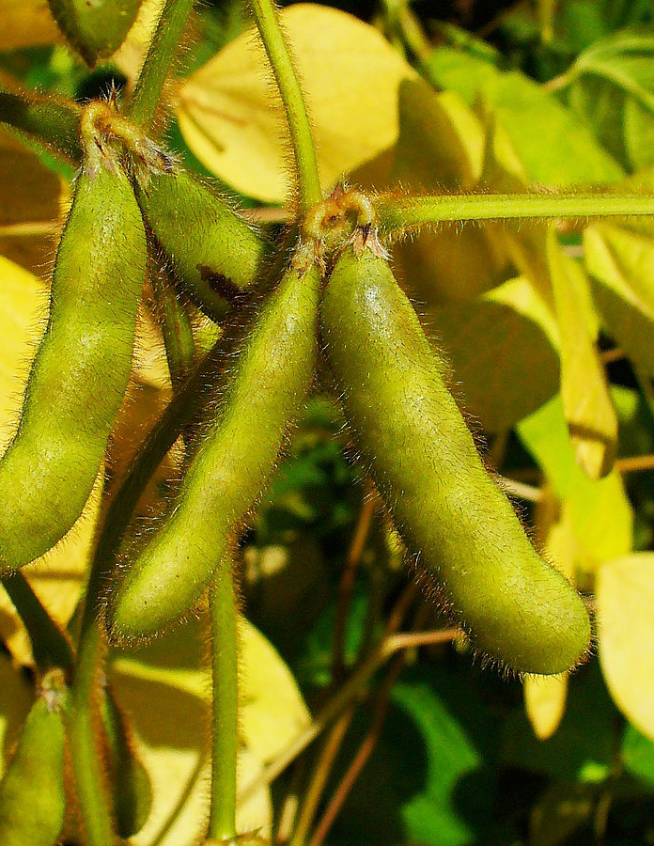
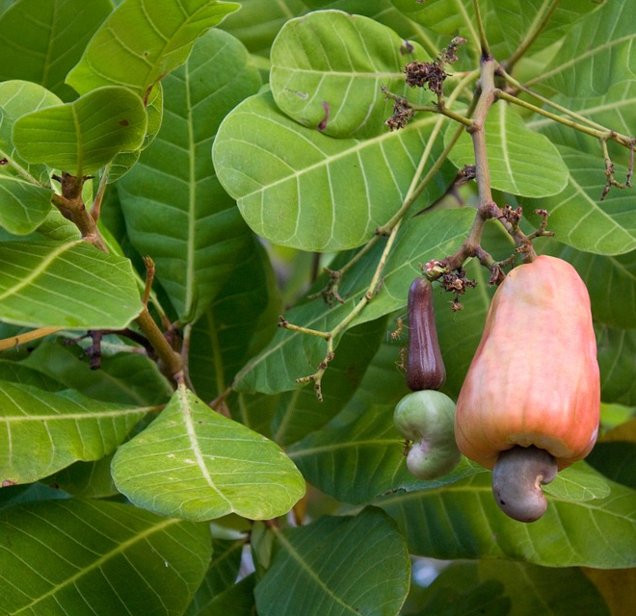
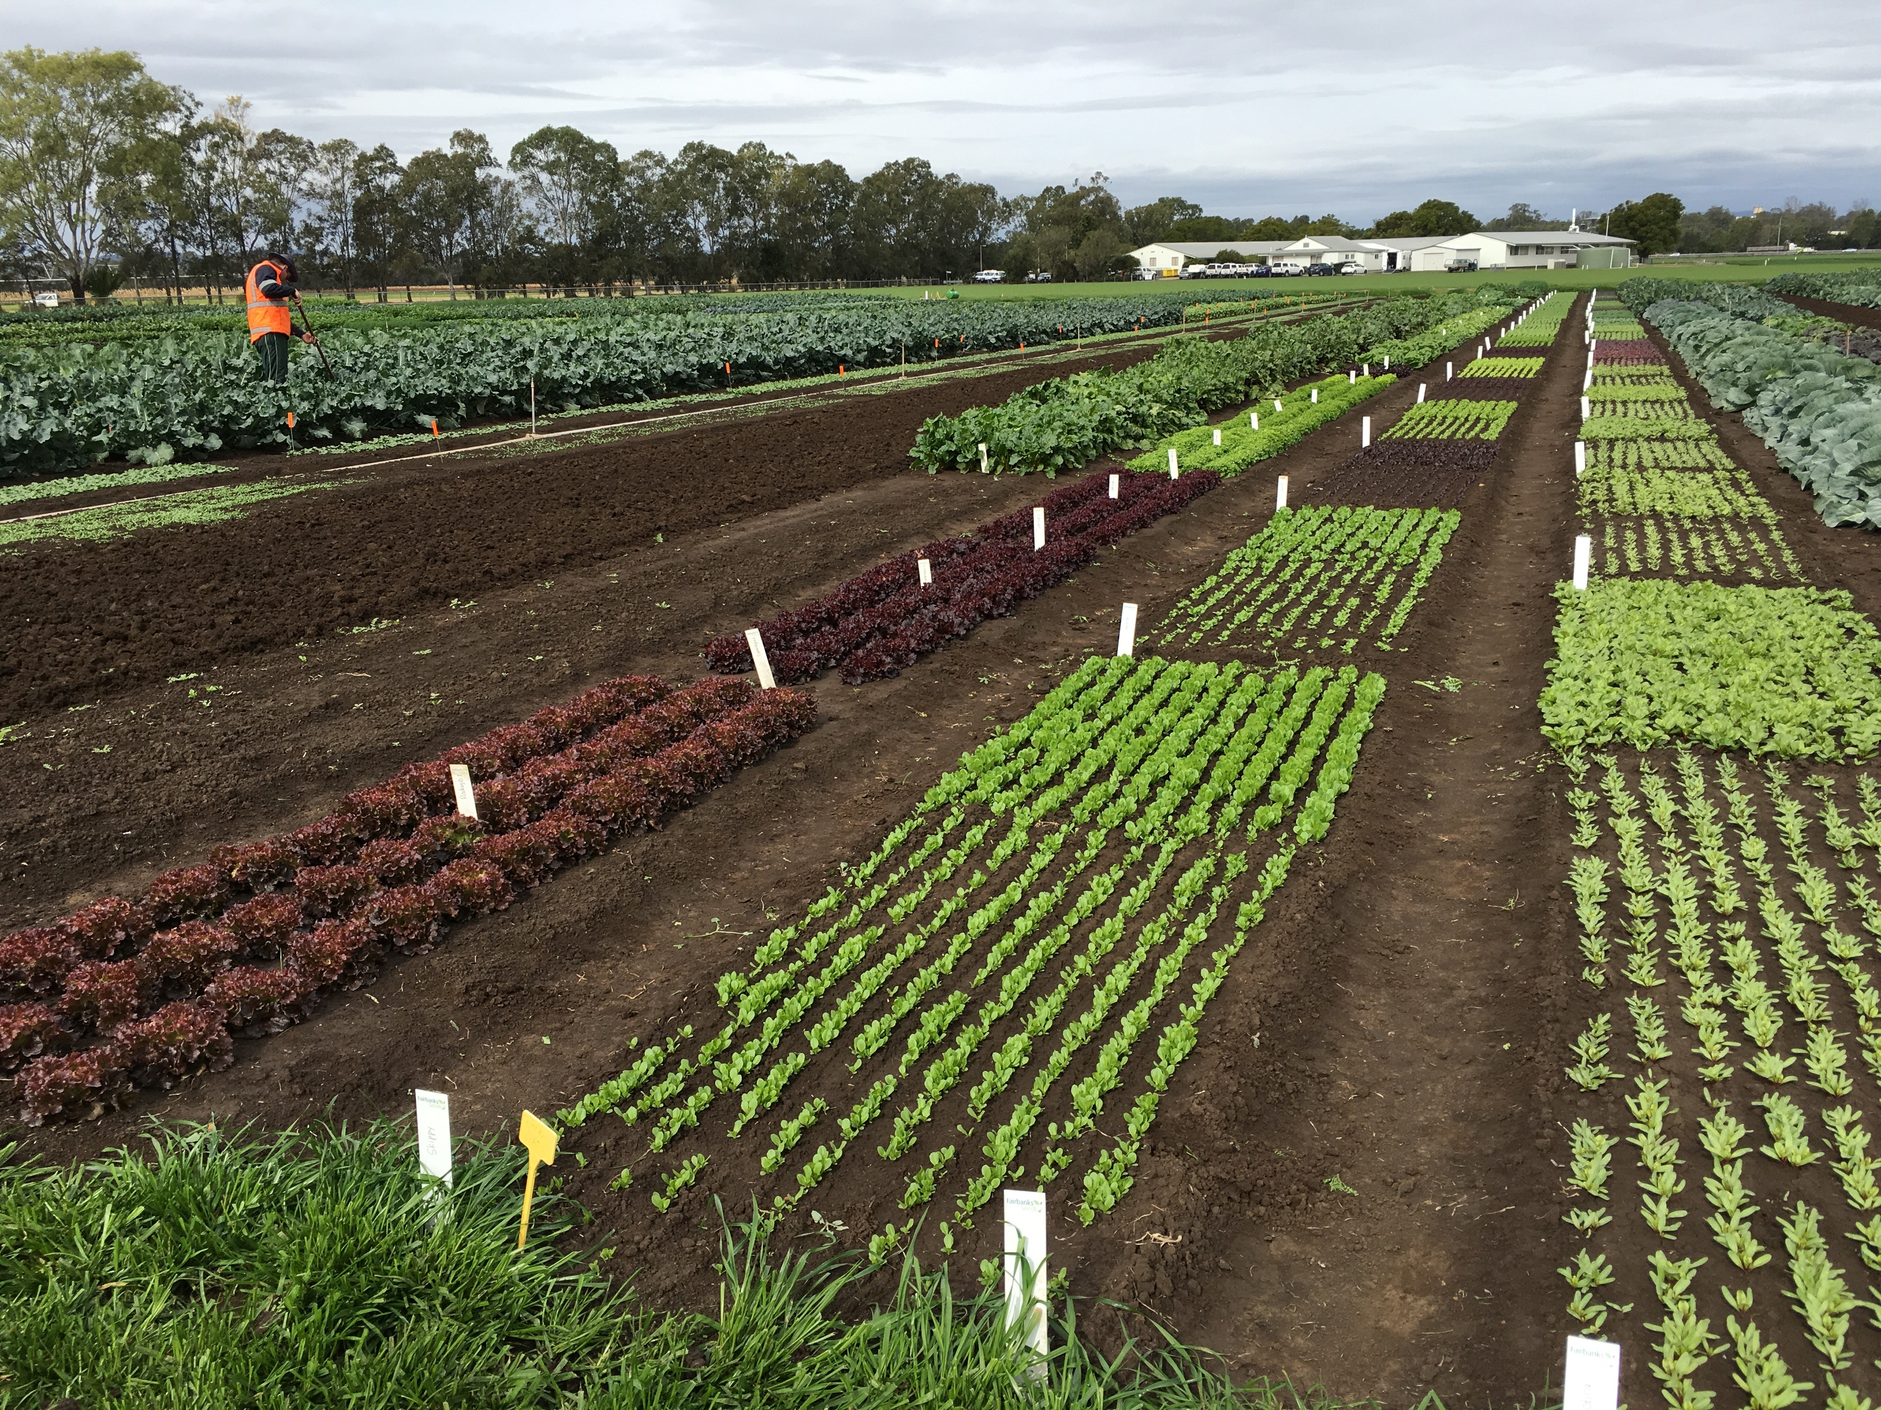
Agricultural Constraint
Poor agricultural policy, legal and regulatory framework and implementation of the existing framework that inhibit the equitable and efficient functioning of input markets, vertical coordination of value-chains, and input and output market competitiveness.

Slide 4
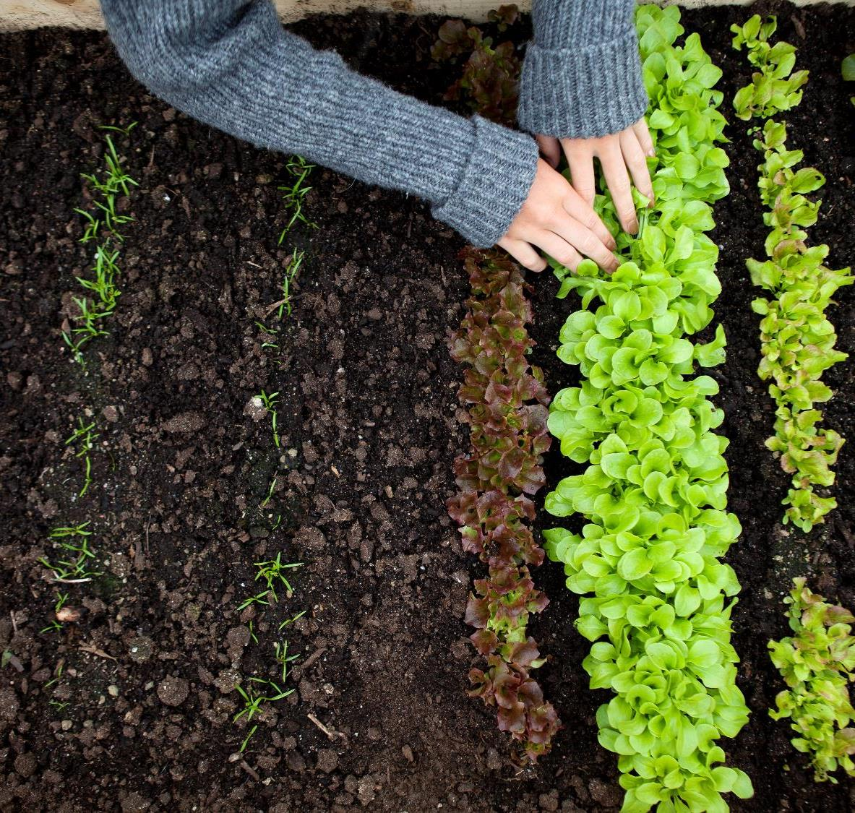
Root Causes

Slide 5
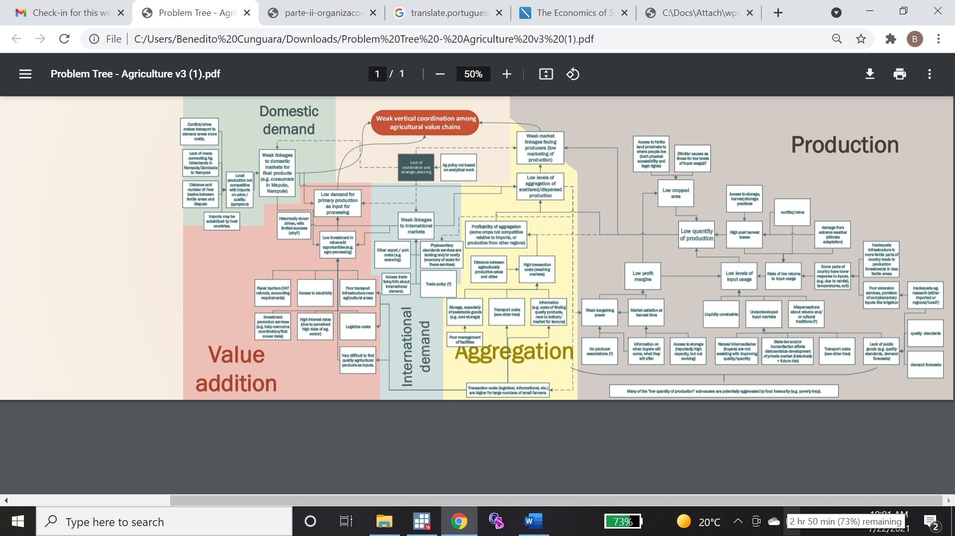

Root Cause visualization
Notes:
We’e going to be revising to make more streamlined and targeted

Slide 6

Key constraints limiting investment
Limited commercial agricultural investment which limits market access
    International market access: Export processes, SPS certifications are inefficient
    Local markets: aggregation capacity, transaction costs, production quality & competitiveness impact local demand
Lack of coordination in: seed sector, extension services, other input supply
Poor Infrastructure leading to low investment: transport costs, electricity access, communications
Burdensome fiscal policy: VAT refunds (17%), IRPC (32%), autonomous tax (35%)
Expensive and difficult to access agricultural credit
Understanding of environmental impacts and opportunities
Unequal opportunities for women and youth
Notes:
On Ag credit, look to compare the rates with neighboring countries

Slide 7
Agricultural production is very vulnerable to the effects of climate change (primarily flooding in Zambezia)
The Ministry of Environment deals with Climate Change (Contribuição Nacionalmente Determinada NDC (2013-2025- each institution should prepare Action Plans to mitigate climate change). The Ministry of Agriculture faces lack of funds to implement the NDC Action Plan;
Weak internal planning aimed at climate change and lack of capacity for research and investigation of new technologies
Lack of sensitization in terms of Climate Change Issues;
Lack of funds to capacitate various stakeholders to deal with Climate Change;
Reduced numbers of designed programs in order to contribute to the country's sustainable development and simultaneously contribute to avoid the condition of greenhouse gases. greenhouse effect,
Lack of deforestation reduction programs;
Collection, disposal and treatment of waste, including capture, burning and possible use as energy source of biogas from waste landfills urban solids and sewage treatment plants.
No specific Climate Change Policies for Agricultural sector

Slide 8


Important Considerations
Private sector often has to step in and provide governmental functions, such as financing community infrastructure, connecting to power distribution network and providing road maintenance
Use of improved inputs is highly variable and related to linkages to markets (leaf tobacco, sugar, cotton) and locations/cross border
Policies are “on the books” but not executed or are incoherent/noncomplementary – there are more than 20 ag policies
Policies are conceived without much consideration to the specificities of the markets e.g. autonomous tax VAT reimbursements
Securing DUATs for commercial scaling is often challenging given the slow and not transparent titling awarding process
Given the GoM priorities there is high Likelihood of having Compacto II program focus in Zambezia, which has been underinvested despite its high Ag potential (to include aquaculture)
Notes:
Policies incoherent: for example PEDSA, PNISA, PQG, PAPA, SUSTENTA, PODA, PRODAP, etc 21-25 total policies
The current system is not set up to correctly file taxes for purchasing from smallholders
DUAT process results in investors spending extra resources to consult with communities and resolve conflicts before beginning investment

Slide 9
Important Environmental Considerations
Land security for small holder farmers is also a challenge (according to Land law, land belongs to the State);
Lack of capacity in different levels (upstream to downstream);
Provide agricultural Insurance to guaranty the mitigation of Impacts related to Climate Change;

Slide 10
Commodity Matrix for Zambezia

Slide 11
SUSTENTA
National policy for the integration of smallholder farming in commercial value chains beginning in 2019
GoM’s Core Priority in the agriculture sector to benefit mostly smallholder farmers, PACEs, and SME agribusinesses
The intervention includes subsidized technology packets (inputs like seed and fertilizer) to include some mechanization; concessional credit; and access to extension through lead farmers.
Primarily production focused but gaps exist in finding markets for goods
(Find diagram of intervention)
Placeholder – how much total is being invested and what the program looks like in Zambezia
Notes:
Government is investing large amounts on this program aimed at increasing smallholder production and focused on expanding (albeit subsidized) improved input use

Slide 12

POTENTIAL SOLUTIONS

Slide 13
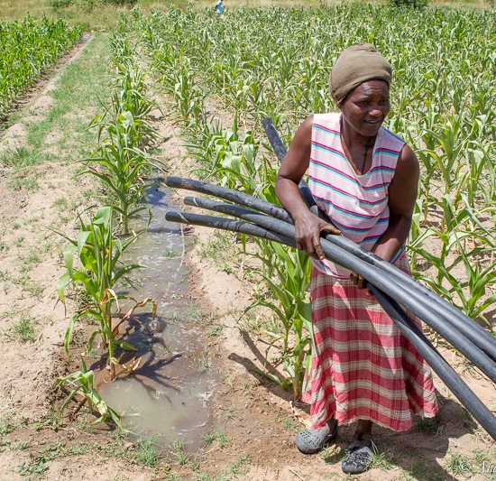
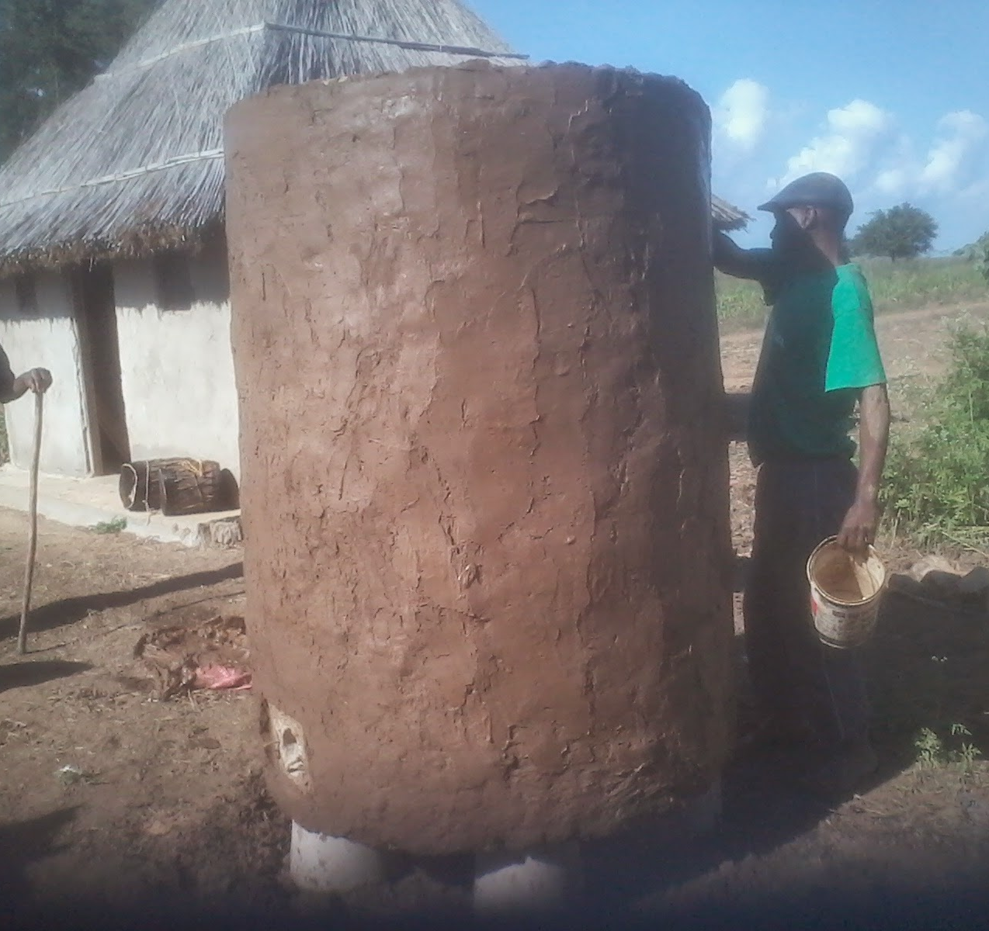
Objective Statement
To increase the competitiveness of the agricultural sector by facilitating and promoting commercial investment in agricultural production and processing by fostering the private sector’s ability to overcome initial hurdles to entry, reforming investment enabling policy and vastly expanding and improving the rural transport network. Additionally, the project will seek to restore and conserve productive ecosystems to reduce the net environmental impact of the investment and improve livelihoods. Opportunities for income generation will have an emphasis on inclusion and sustainability.

Slide 14
Opportunities in Zambezia
High Agricultural potential with good soils and on-average rainfall
Connectivity via tertiary roads
Zambezia rests between several destination market outlets: Blantyre, Nampula-Nacala, Quelimane
Connectivity creates market opportunities and increases access to inputs and extension as well as information
Currently many roads in region (LZ5) are unimproved and hard to access in rainy season constraining access to a large number of buyers, sellers, and large agro processors.
Intermodal Development Plan including a detailed transport plan, outlining measures to smooth the transportation of cargo in the region.
Food surplus province with diversity of products: maize, soy, cassava, pigeon peas (feijão boer), rice, peanuts, cashews, sesame, vegetables, and tobacco, fruit, tea, livestock
Existing export of pigeon peas, sesame and cashew nuts
Production of inputs for animal feed: Soy and Maize and beer production: Maize and Cassava
Aggregation of minimally processed products such as maize and rice
Aquaculture
Agroforestry and Fishery Ecosystems
Notes:
There are no shortages of transporters in the province; however, during normal harvest time there is a greater demand for transportation for pigeon peas, soybeans, sesame, and nuts. However, transporting goods to the districts during rainy seasons could be a challenge. To add the amount of arable land. Also stress that current cost of transport is very high and lowering the cost will improve the business case

Slide 15
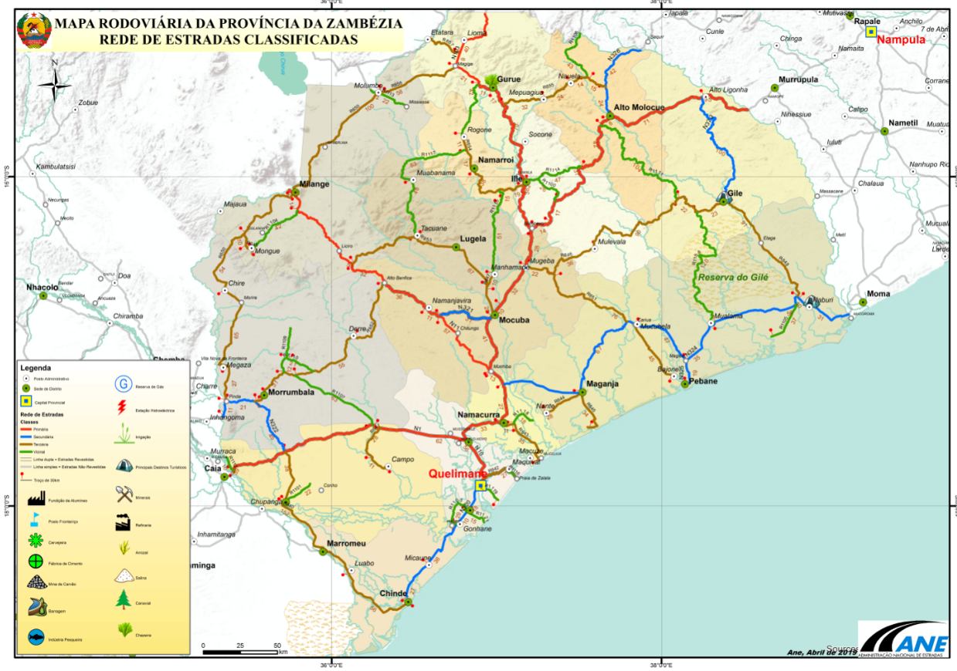
Example Areas of Priority, linked to transport
Gurue – Alto Molocue
Gurue-Lioma-Molumbo
Mocuba – Quelimane
Lioma-Malema
Notes:
Important consideration of the forward market linkage to Nampula on to Nacala, Northwest on to Blantyre, or to Quelimane; add information related to the size of the province in comparison to other countries; the province has one 1/5 of countrie’s population

Slide 16
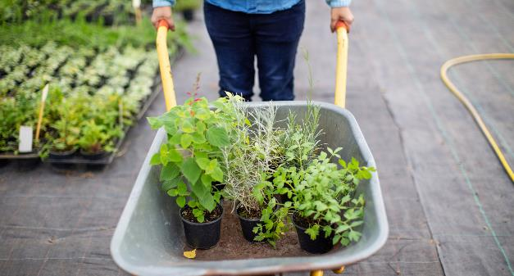
Expanding the Influence of Commercial Agriculture in Zambezia Province
Opening up opportunities to invest in agriculture
Complementing existing Sustenta & GRM Investments
Creating conditions and incentives to secure long-term investment in agriculture through reform
Supporting enabling infrastructure in roads, electricity, and communication services
Increasing affordability of initial financing or access to capital
Financial support to build capacity of producers, potentially through outgrower or anchor farm models
Assistance in targeted community development with social and economic outcomes (i.e. small irrigation investments, boreholes, schools, etc.)
SUSTENTA remains very focused on increasing smallholder production but there is a need to expand commercial opportunities
Compacto II aligns with timing of PNISA II budgeting and planning
Piloting investment for future investments such as Mugeba
Creation of jobs along value chains, builds opportunities for investment in agrodealers and other entrepreneurial initiatives
In fisheries/aquaculture, opportunity to assist GRM in restoring productive ecosystems/animal feed
Notes:
For example investments in feed, have downstream impacts on livestock/aquaculture production

Slide 17
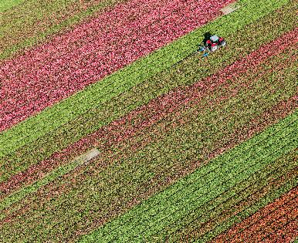
Areas of Opportunity in Policy and Institutional Reform
Seed certification unit
Value add Tax and corporate exemption
PPP Doing Business at Provincial-level
Reform model of USEBA to incorporate private functions
Enhance quality control and awareness
Facilitate timely approvals and decision-making
Reducing tax overburdensome - IRPC 32% + potential autonomous tax rate of 35%
Streamlining VAT reimbursement process
Addressing existing VAT reimbursements
Work towards increasing indicators based on further study
ECOSYSTEM SERVICES SUSTAINABILITY
Export streamlining
Commitment to stop mangrove destruction
Managed agroforestry
SPS inspections /certifications holding up import/export
Electronic Single window processes
Revise role of brokers (create more competition)
Equal Treatment in Private Sector
Adapting gender discrimination regulations from public sector to private
Notes:
When promoting commercial ag development and investment, these are the existing issues that deter investment.

Slide 18
Focus on Climate Opportunities
What are the opportunities and risks?
Improved inputs that are accompanied by insurance
Agroforestry opportunities and management
The use of national policies to adapt to climate change (i.e. climate smart Agriculture from MADER)- Improve the Policies
The Ministry of Environment deals with Climate Change (Contribuição Nacionalmente Determinada NDC (2013-2025- each titution should prepare Action Plans to mitigate climate change). Improve and Finance the Action Plan
Create and Institutionalize a Research Center. For this, capacity Building is required.
Sensitization in terms of Climate Change Issues;
Capacity building (training stakeholders);
Design programs in order to contribute to the country's sustainable development and simultaneously contribute to avoid the condition of greenhouse gases. greenhouse effect,
Deforestation reduction programs - Ecosystem services –mangrove restoration
Reforestation programs for the production of charcoal from renewable sources expansion of electricity generation from renewable sources;
Collection, disposal and treatment of waste, including capture, burning and possible use as energy source of biogas from waste landfills urban solids and sewage treatment plants.

Slide 19
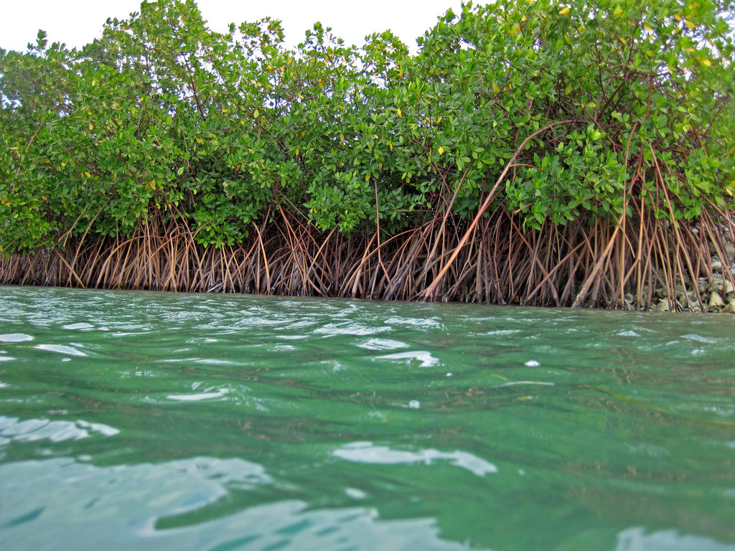

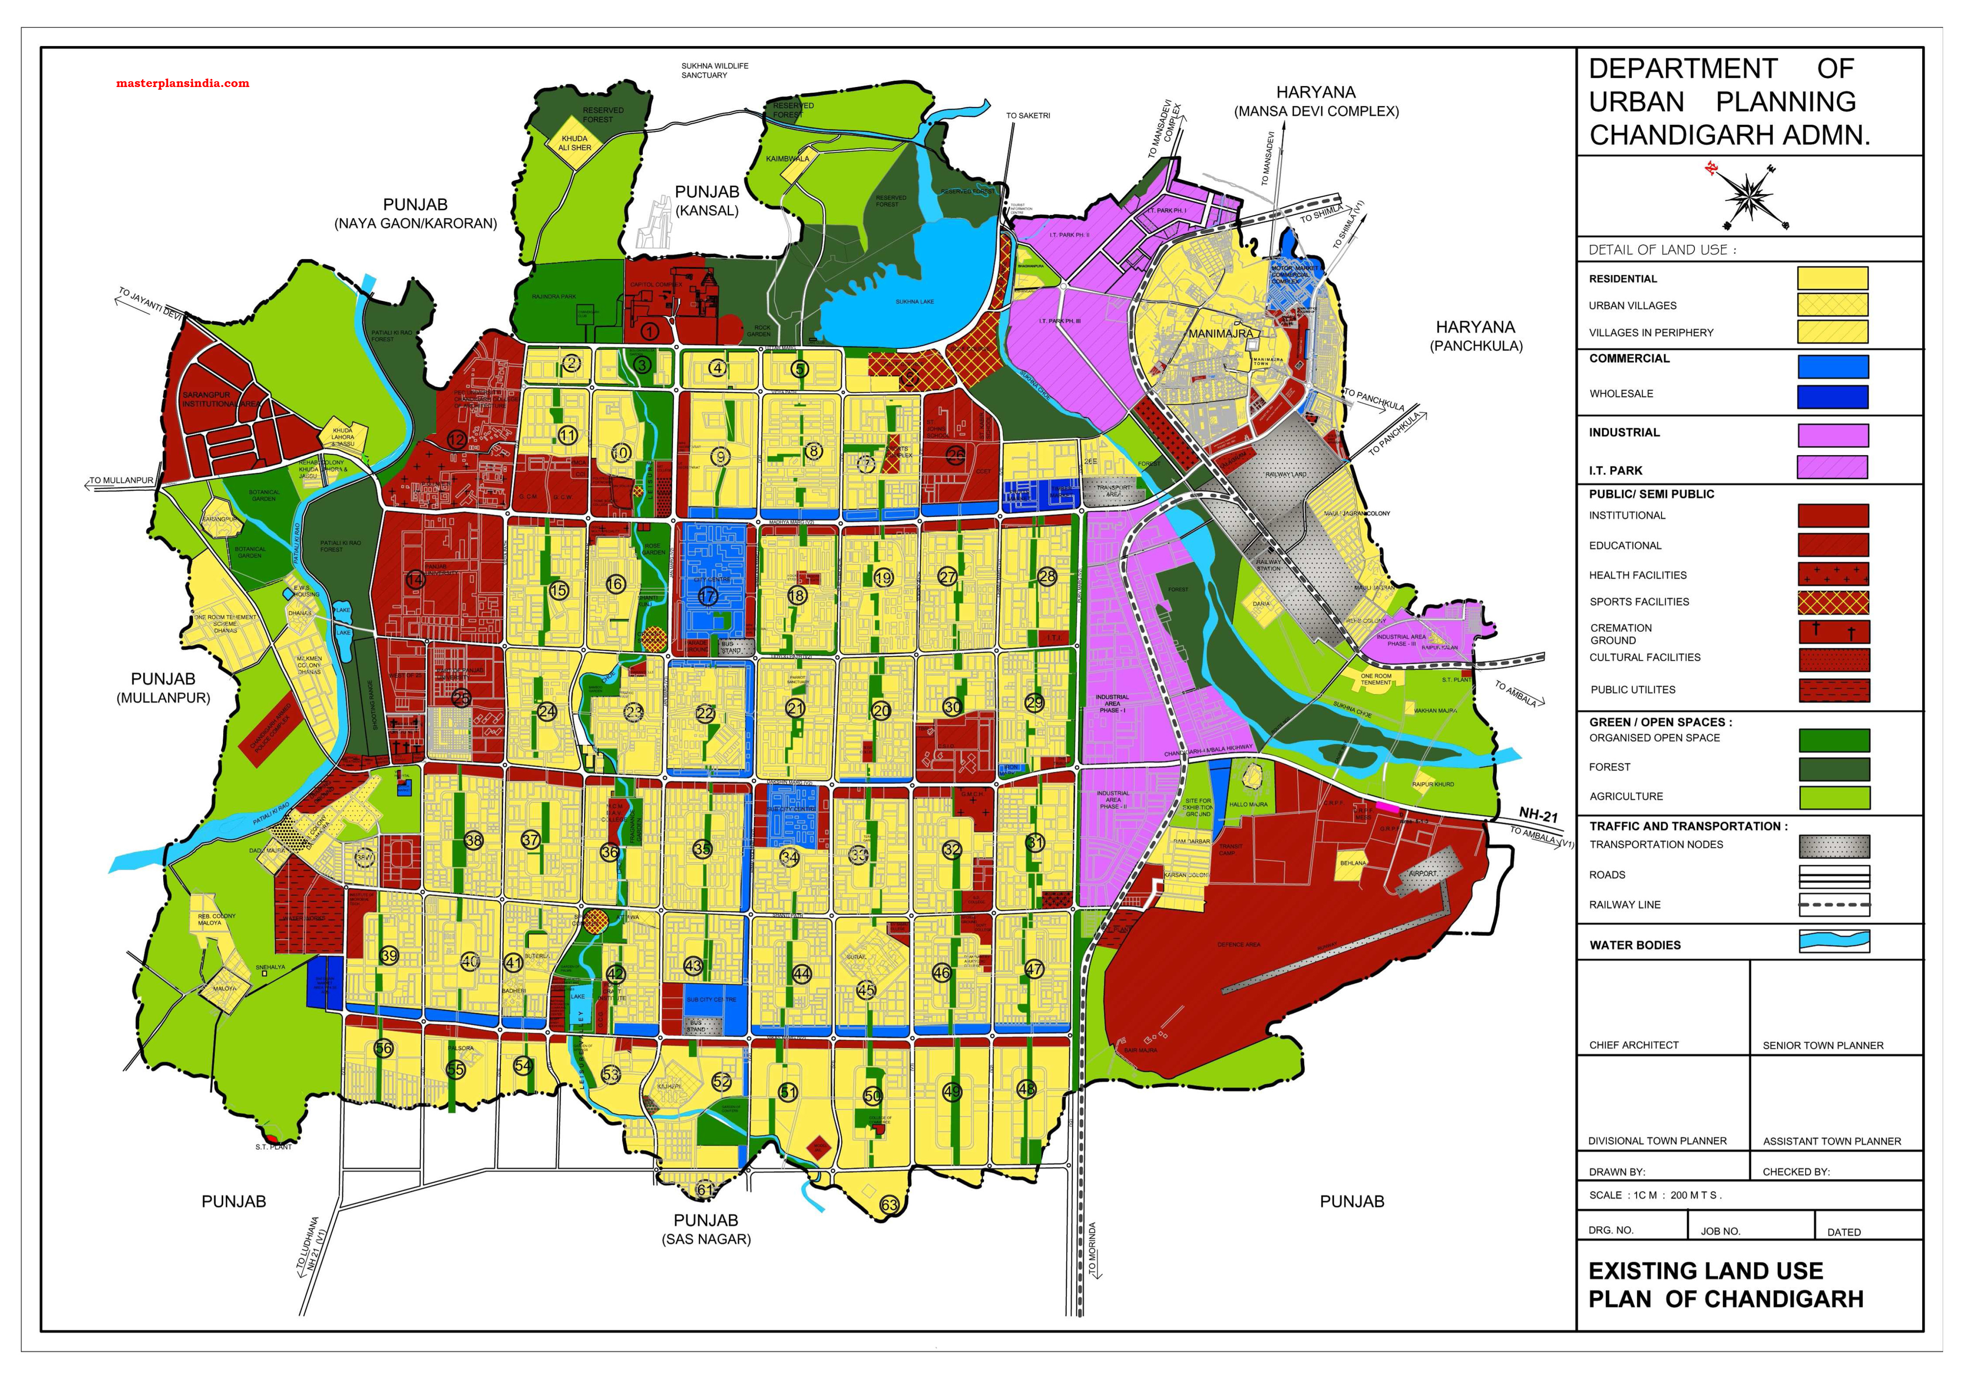
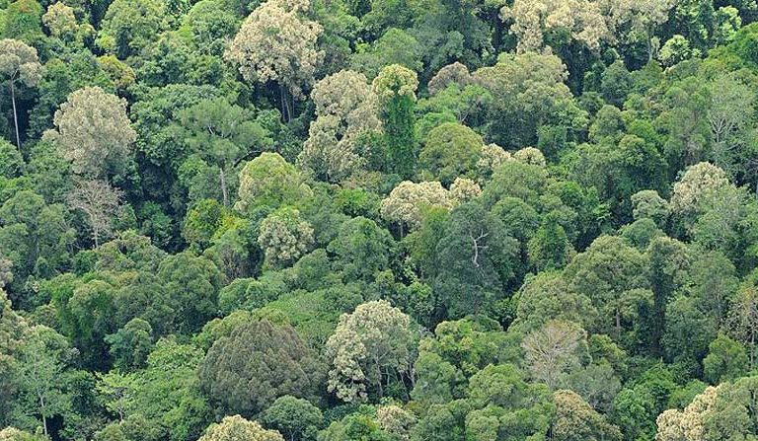
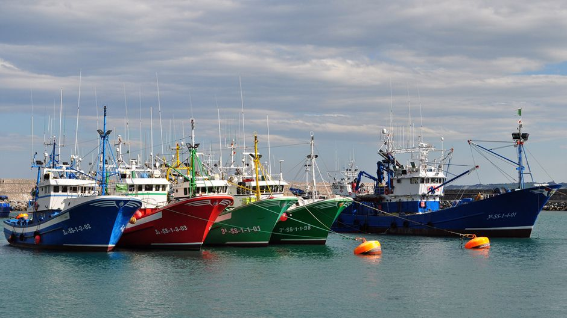
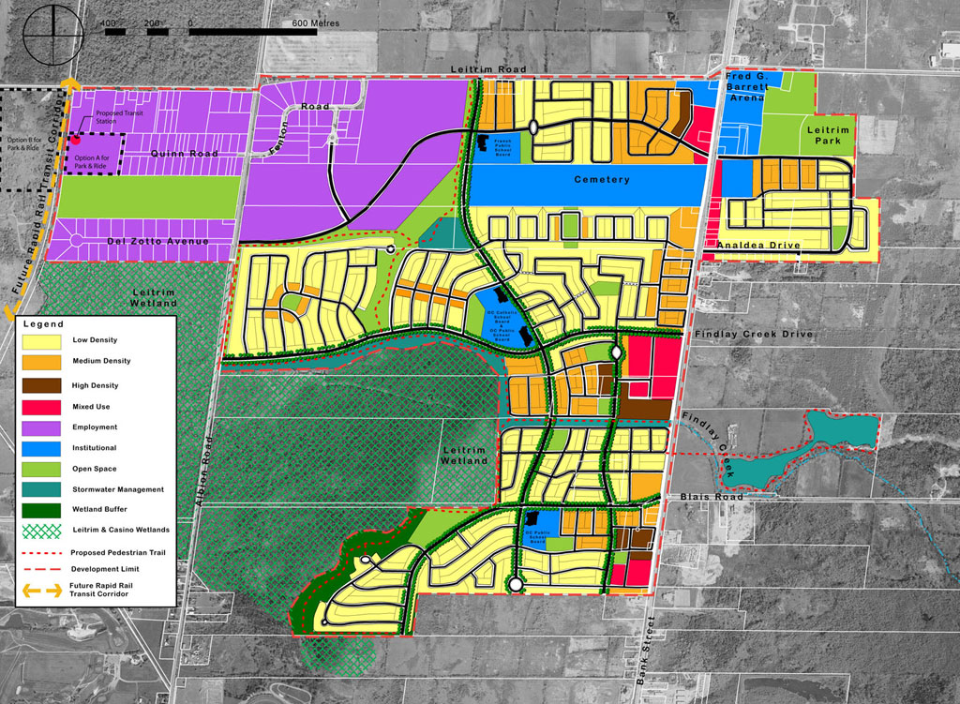
Climate Opportunities
Up to 20,000 hectares of mangrove, coral or seagrass restoration and conservation linked to increased fish stocks
Carbon credit programming using certification systems to sell credits and improve livelihoods (i.e. cashew)
Land Use planning and management
Reforestation along corridors and roads
Fisheries management system such as cap and trade
This Photo by Unknown Author is licensed under CC BY-SA-NC

Slide 20




Private Market Actors in Agriculture and Aquaculture Value Chains
Possible Support Mechanisms
Parallel Investment Grant support for initial infrastructure investments (including electricity access) and community engagement
Business Development Services
Technical assistance in applying reforms
Assistance in outgrower/anchor models
Roads connectivity
Compliance and traceability systems
Anchor Investments in Agriprocessing and Agridealers
Accessing capital/credit
Assistance (through agriprocessing/agridealers) to access inputs (seeds, fertilizers, etc.)
Roads connectivity
On-farm infrastructure (storage, irrigation, etc.)
Private extension
Anchor Market-oriented production
Assistance (through agriprocessing/agridealers) to access inputs
Roads connectivity
Cooperatives development
On-farm infrastructure
Private extension
Family production
Notes:
We will improve the diagram showing where supporting commercial investments will complement other government and donor initiatives

Slide 21

Opportunities in Gender and Social Inclusion
Prioritizing Women’s Economic Empowerment
        Target jobs & market linkages
        Community care infrastructure to open up opportunities for women
        Look towards successful programs like Cataliza
        Focus on gender-based violence advocacy
        Engagement of contractors to include gender sensitization, looking at Anadarko example in Cabo Delgado

Slide 22

Identified Needs through Compact Development Funding
Appetite for investment study (“call for potential entrants”)
Impact analysis of policy and reform measures
Market analyses and value chain assessments
Doing business assessment specific to Zambezia
Strategic Environmental and Social Impact Assessments
This Photo by Unknown Author is licensed under CC BY-ND

Slide 23

Links to Economic Growth and Poverty Reduction
Overall target is long-term investment in rural population
Increased jobs and investment in rural and coastal areas
Increased sales of agricultural and aquaculture production (both commercial and familial)
Increased resiliency of fish stocks
Increased availability of improved agriculture and animal protein for nutrition
Economic empowerment of women and youth
Knowledge diffusion and capacity building of smallholders
Spillover to other sectors from increased competitiveness
Improved economic resiliency
Notes:
Why is commercial agriculture worthy investments- Jobs creation, technology transfer, Markets to Sustenta producers

Slide 24

Next Steps in Compact Development
August ‘21
June ‘23
Compact signing, marking the end of Compact Development
MCC prepares Opportunity Memo to advance to Project Definition phase
Sept ‘21 –Aug ‘22
September ‘21
Investment Memo is prepared along with Compact and activity budgets, timeline and targets*
March ‘23
GDCII submits Final Concept Note
Development of Project Proposal and Assessment Memo, meaning the activities of the Compact will be developed and agreed upon*

Slide 25

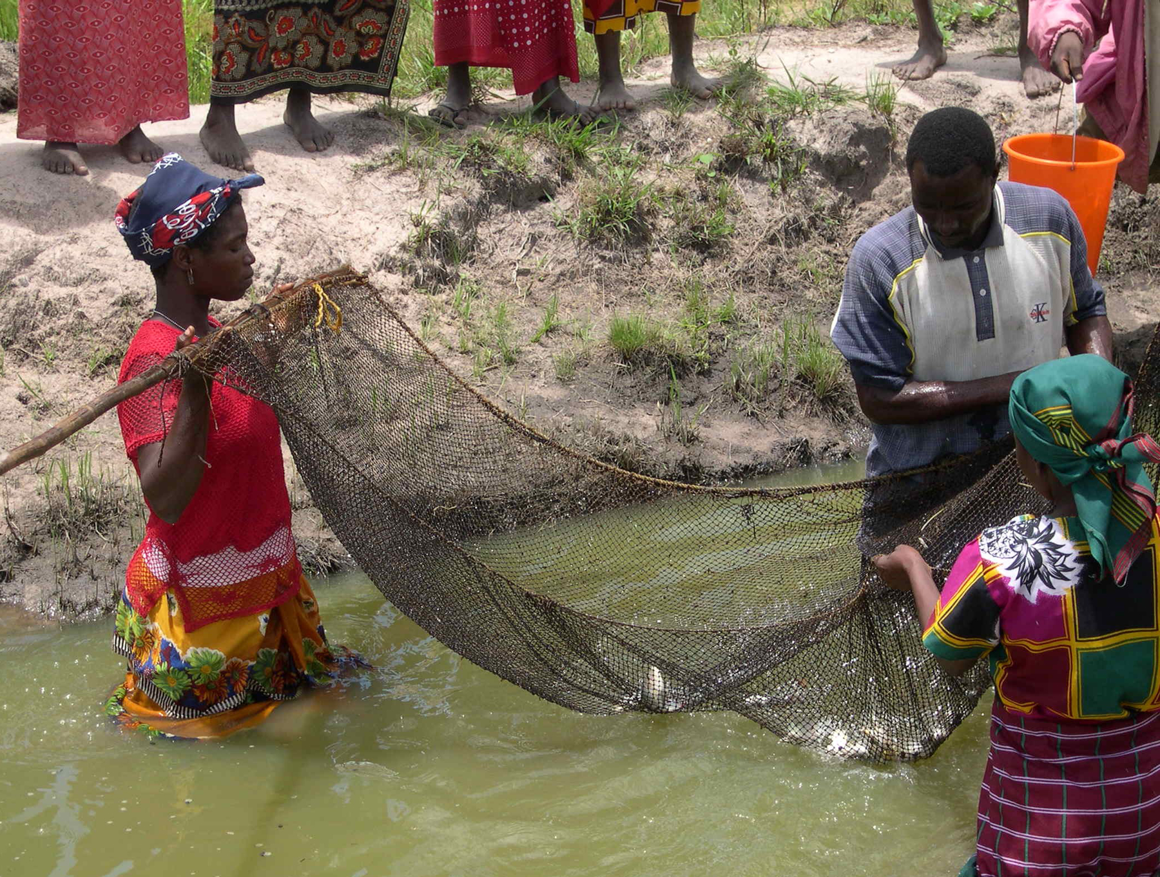
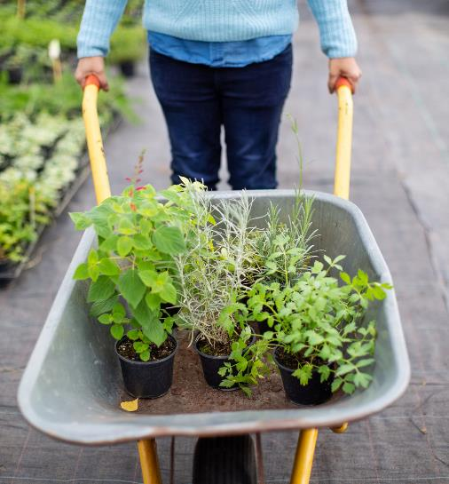
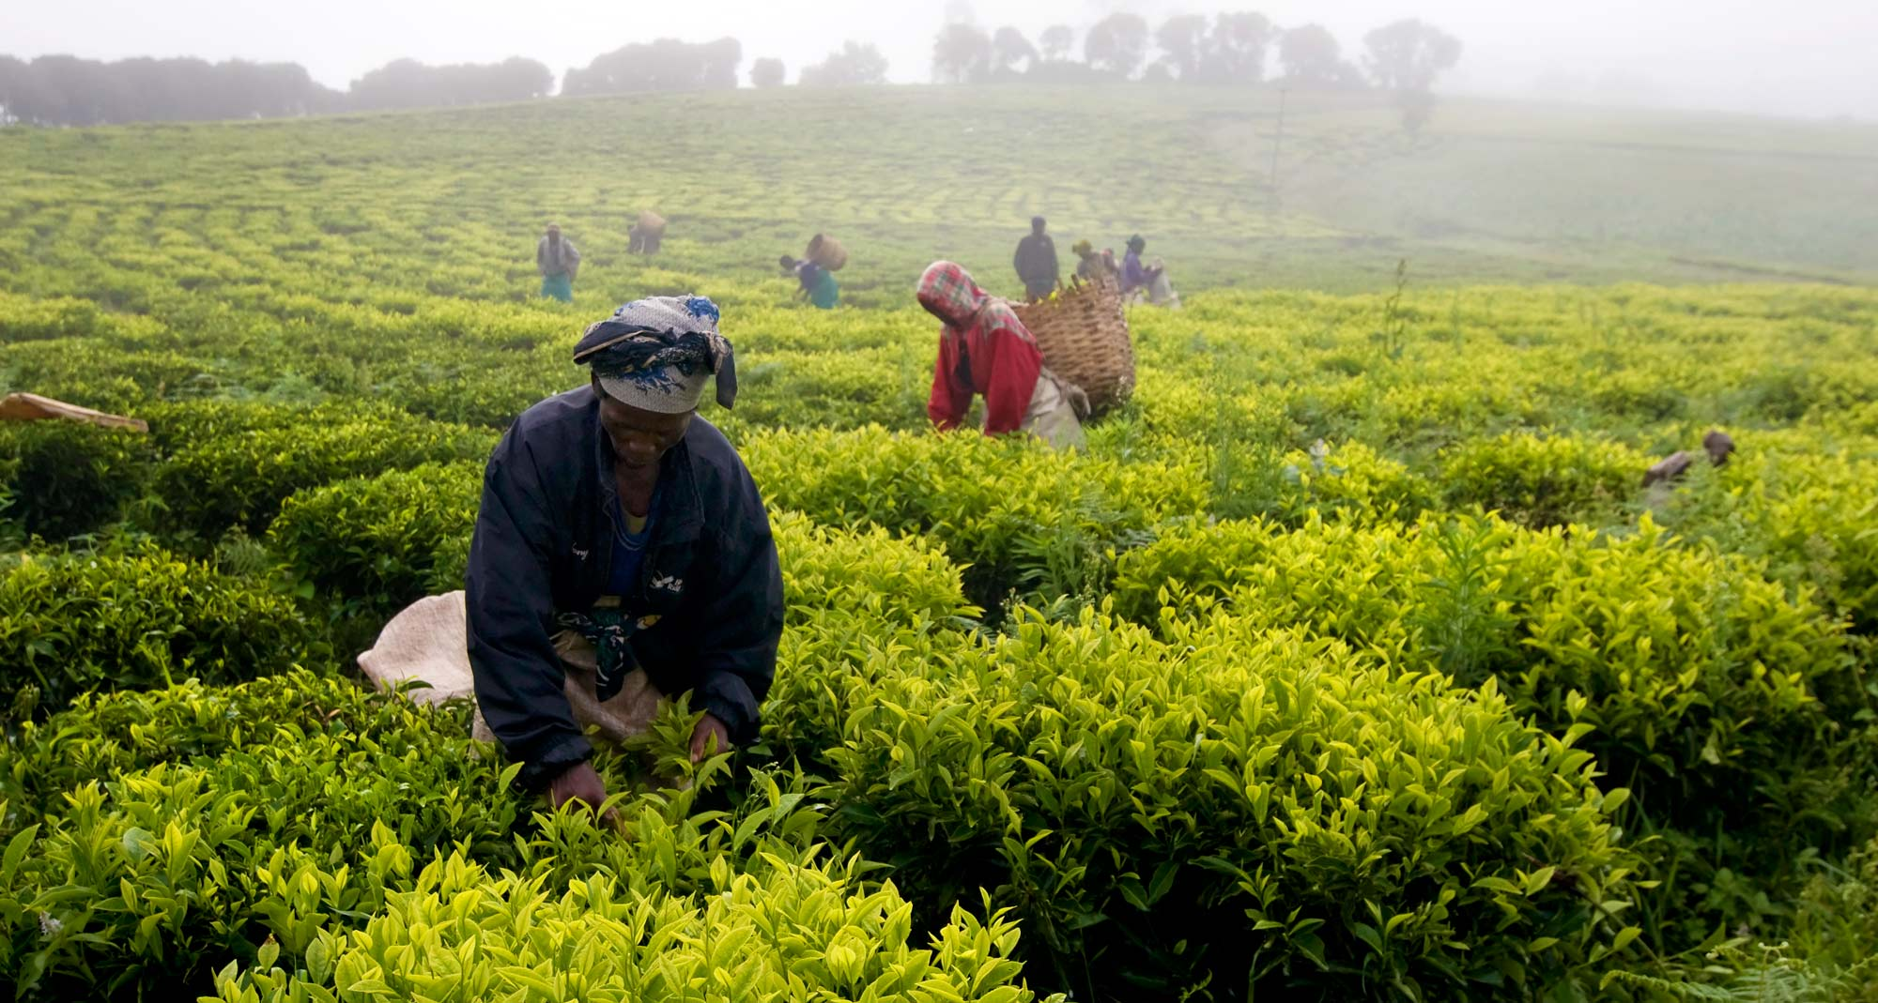
Thank You!
Muito Obrigad@!

